Slide 1

Competitive Programming 234901
Introduction
Notes:
Write on the board:
Please make sure you have access to vjudge:
Register at vjudge.net
Have a laptop with internet connection in class

Slide 2
Teaching Language?

Slide 3
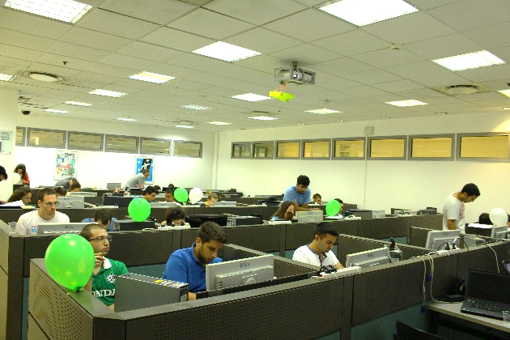
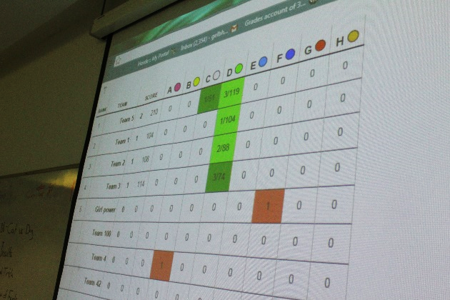
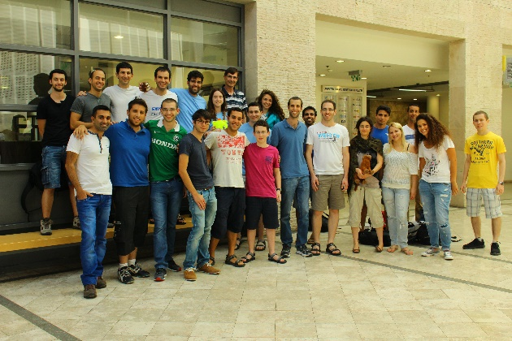
Agnda
Workshop Goals
Overview
Class Work
Homework
Final Competition
Introduction to ACM-ICPC
Warm-up problems
break
Warm-up competition

Slide 4
Workshop Goals
Introduction to competitive programming
Assemble a team for the ACM-ICPC regionals
Get hands-on experience
Develop intuition
Sharpen your programming and team-work skills
Have fun!
Notes:
`

Slide 5
Administration
3 Academic Points
Prerequisites
Data Structures 1
Algorithms 1
(Or equivalent courses in other departments)
”Reshima Alef”
The course is not considered as a project or seminar
Manual registration
Tuesdays 16:30-19:30, Frontal and Online
Mandatory!

Slide 6
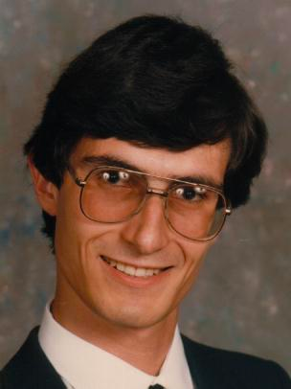

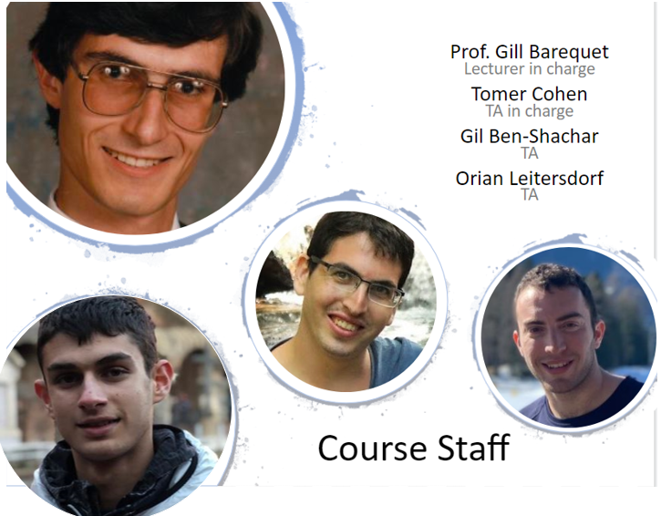
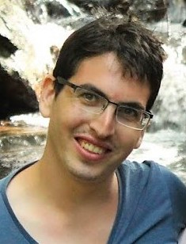

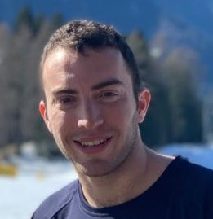
Course Staff
Prof. Gill Barequet Lecturer in charge
Tomer Cohen TA in charge
Gil Ben-Shachar TA
Orian Leitersdorf TA

Slide 7
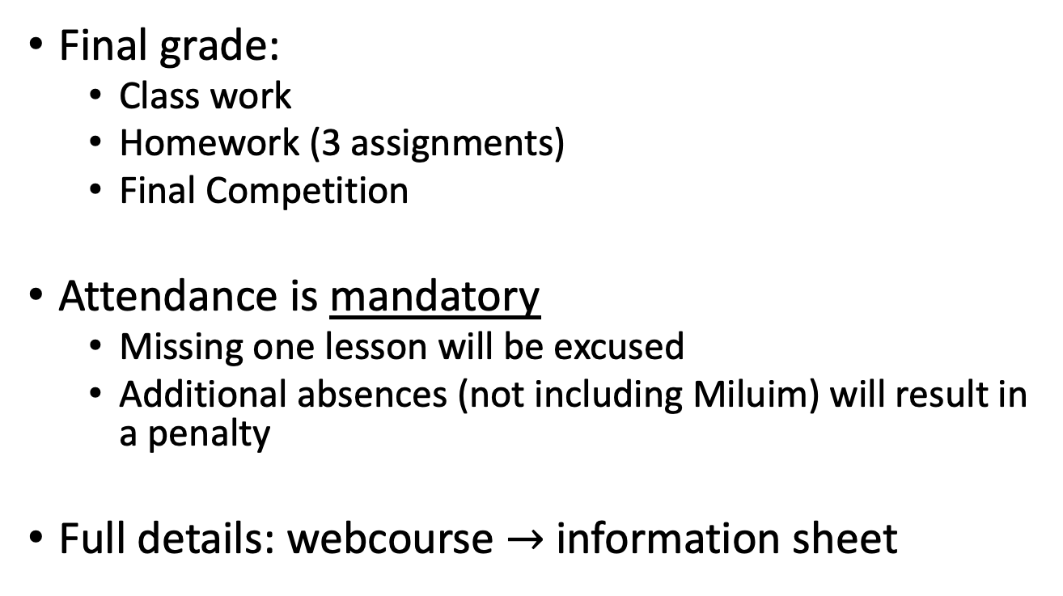
Grading

Slide 8
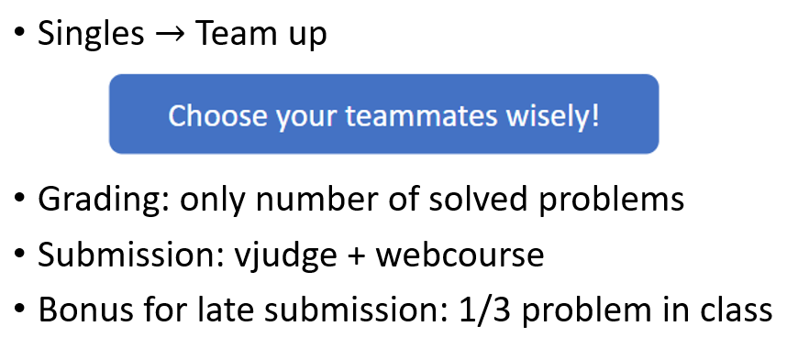
Class Work & Assigments
Notes:
Usually people stay with the same team all semester. If you want a chance to go to the regionals, team up only with eligible students.

Slide 9
Estimated Schedule
Introduction
Data Structures
Problem Solving Paradigms
Math
Graphs
Geometry
Strings
More DP
More Geometry
More Graphs
Sponsors Event (?)
Advanced DP
Mini competition
Final competition
HW0
HW1
HW2

Slide 10

Using Zoom
What if I have a question?
During the lecture part:
Raise your hand
We will approach you
Unmute yourself and ask it
During the competition part:
Raise your hand
A TA will add you to a “breaking room”
Ask the question in there
(when the competition will be in groups this will be changed).

Slide 11
DO NOT CHEAT!

Slide 12
Final Competition
Friday, 01/07/2022 (Depends on the covid situation)
attendance mandatory!
Format: similar to ACM ICPC.
The best eligible team will be invited to represent the Technion at the ACM ICPC Southwestern Europe Regionals (SWERC)
SWERC 2022: Europe, November/December (Depends on the covid).
Travel expenses: covered by the computer science department and our sponsors.
All team members must be eligible.

Slide 13

ACM ICPC
ACM-ICPC is an annual multi-tiered competitive competition among the universities of the world.

Slide 14
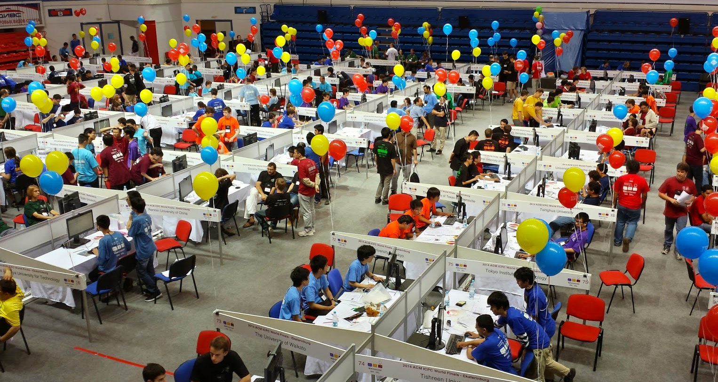
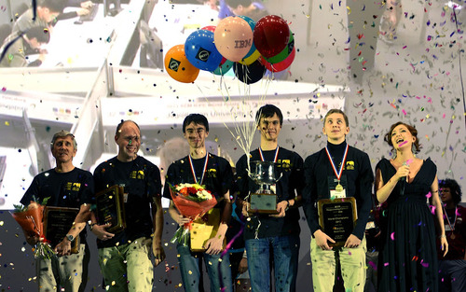
ACM ICPC
The competition is running since 1977 and considered as the most prestigious in the world of competitive programming.

Slide 15
ACM ICPC
The ACM-ICPC Competition has three tiers:
Local Qualification
Each university selects teams for the regionals.
Over 300,000 students throughout the world.
Regionals
30 different regions. The Technion competes in the "southwestern europe" region (SWERC).
World Finals
Top 100 teams (2-4 from each region)

Slide 16
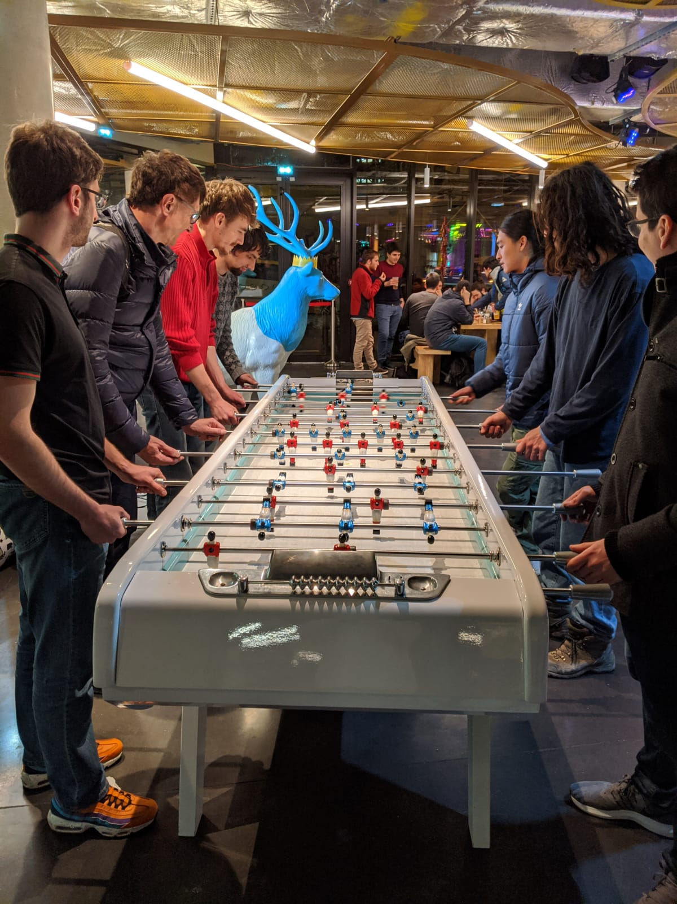
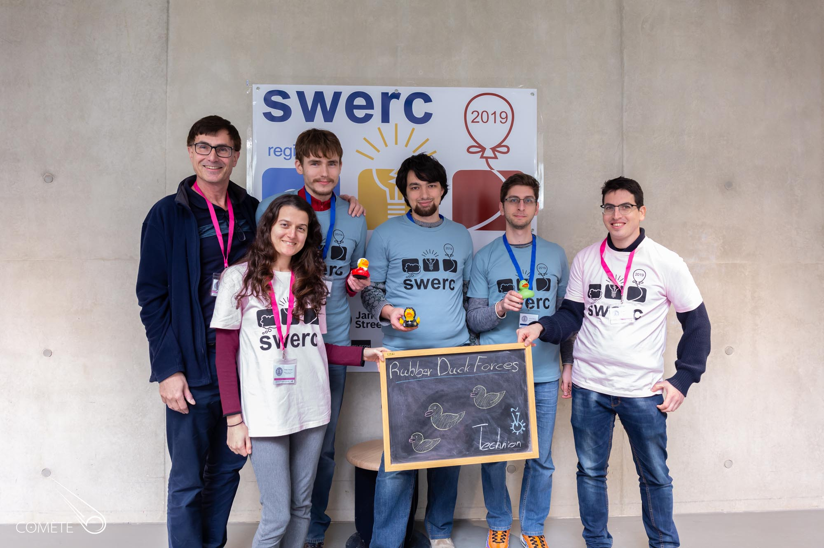
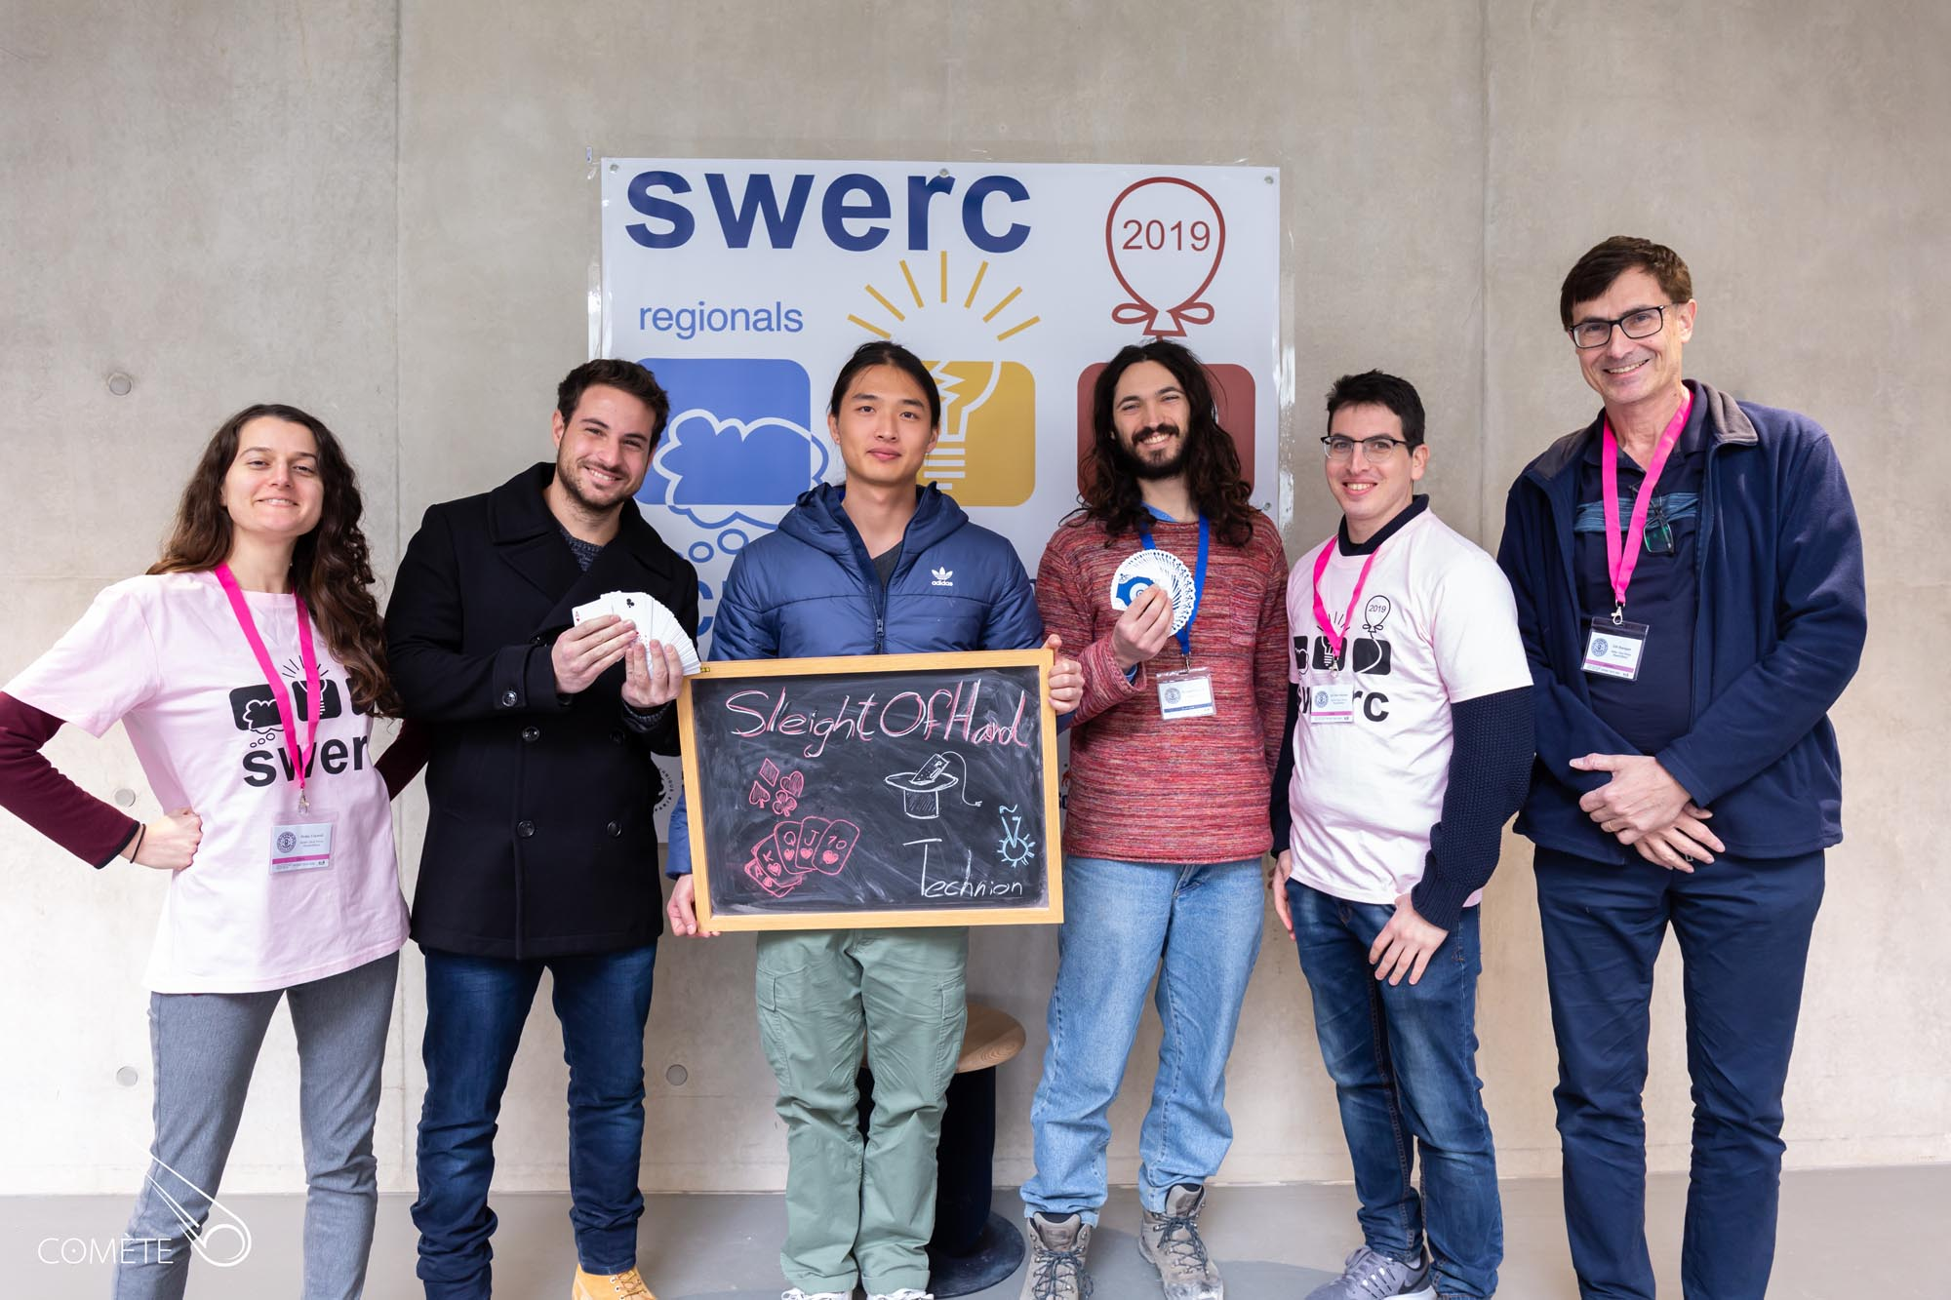
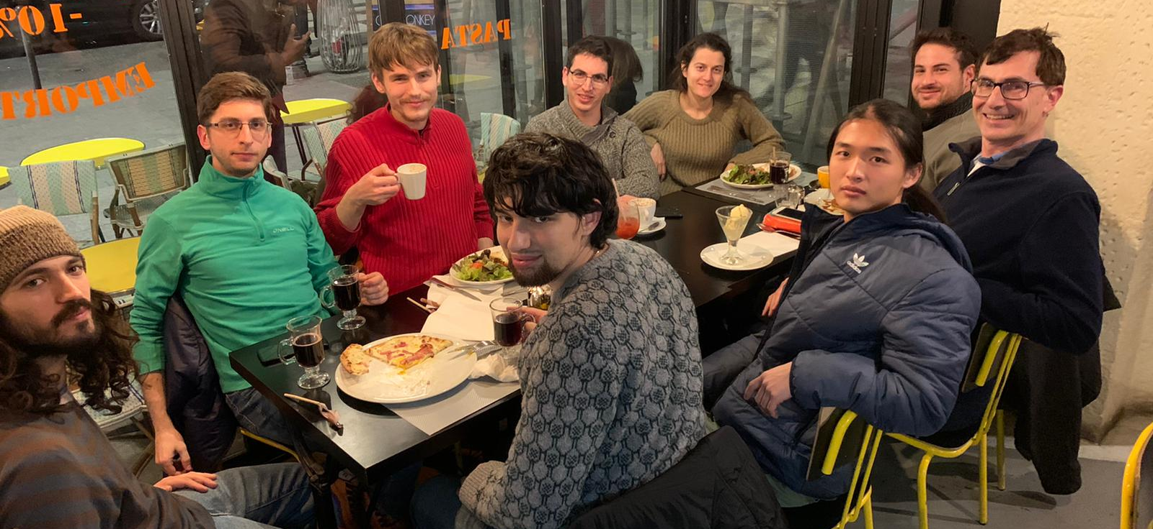
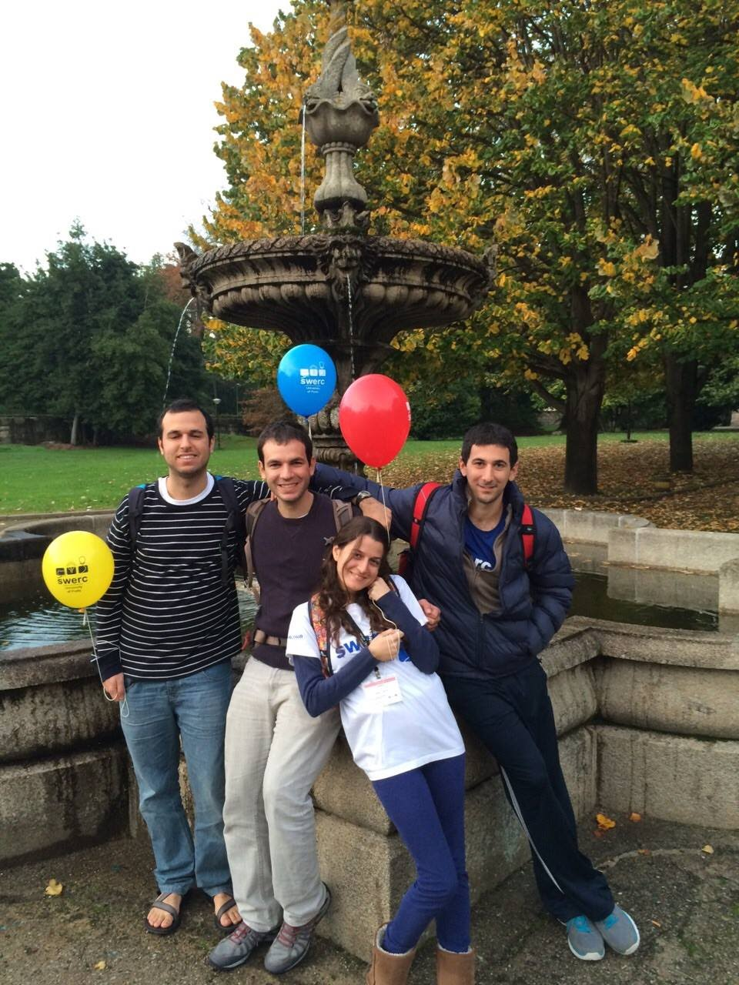
ACM ICPC Regionals

Slide 17
In 2020 the Technion is going to participate for the 16th time.
Previous results:
2006 Romania – Marcello Taub, Michael Gelfand, Kolman Vornovitsky – 30th
2007 Romania – Gill Cohen, Lior Biran, Yaron Yura – 36th place
2008 Romania – Shachar Papini, Yaniv Sabo, Karmi Grushko – 17th place
2009 Spain – Shachar Papini, Yaniv Sabo, Oshri Adler, Itai Levy – 7th place (Silver)
2010 Spain - Shachar Papini, Yaniv Sabo, Karmi Grushko – 2nd place (Gold)
2011 Spain – Omer Tabach, Tomer Fruman, Noa Korner – 16th place
2012 Spain – Idan Elad, Olivier Hoffman, Mike Harris – 12th place (Bronze)
2013 Spain – Alex Goltman, Oleg Zlotnik, Roei Gelbhart – 10th place (Bronze)
2014 Portugal – Eden Saig, Nofar Carmeli, Ori Brusilovsky – 15th place
2015 Portugal – Omer Daniel, Aviram Magen, Itay Zukier – 18th place Nitzan Tur, Ido Hakimi, Dima Kuznetsov – 38th place
2016 Portugal – Omer Daniel, Aviram Magen, Itay Zukier – 15th place
2017 Paris – Dean Leitersdorf , Vova Polosukhin, Artem Shtefan– 6th place (Silver)
2018 Paris – Dean Leitersdorf , Vova Polosukhin, Artem Shtefan– 24th place Ilan Ben Danan, Shira Weiss, Evgenii Zheltonozhskii- 39th place
2019 Paris – Evgenii Zheltonozhskii, Vova Polosukhin, Artem Shtefan– 11th place (Bronze) Ron Hirsch, Michael Zaloziecki, Rui Jiang - 47th place
2020 Remote participation - Alon Feldman, Ido Zohar, Tom Herman - 28th Tal Frankel, Tomer Cohen, Tomer Giladi - 37th

Slide 18
SWERC 2020
https://swerc.eu

Slide 19
Competition format
Teams of three
One computer for each team
8-10 problems
5 hours
Limited reference materials
Automatic Judge

Slide 20
Competition Format (cont.)
Programming languages: C, C++, Java, Python
We will use C++ exclusively
Code editor of your choice
Eclipse, Codeblocks, vim, emacs
The focus is on efficient, correct solutions.

Slide 21
Judge System
During the competition, solutions are submitted to the automatic judge system and checked against predefined test cases.
Run time and memory use are usually very limited.
After submitting the solution, the following answers are possible:
ACCEPTED
COMPILE-ERROR
TIME-LIMIT-EXCEEDED
RUNTIME-ERROR
WRONG-ANSWER
PRESENTATION-ERROR

Slide 22
ICPC Scoring and Ranking
Teams are ranked by the number of problems solved.
Tie breaker: Teams that solved the same amount of problems are ranked according to their total time.
Total time is the sum of problem acceptance times + 20 points of penalty for each unaccepted submission (only for problems that were eventually accepted)
Example:
Total time= +40 (Acceptance time of A) +20 (Bad submission of A) +70 (Acceptance time of B) +20 (Bad submission of B) = 150
Time | Problem | Judge Answer
20min | A | No
40min | A | Yes
65min | B | No
70min | B | Yes
95min | C | No

Slide 23
ACM ICPC – Eligibility
Active student in the Technion next Winter semester? (Ineligible if answer is no)
Willing and able to participate? (Ineligible if answer is no)
first year of postsecondary studies >= 2017? (Eligible if answer is yes)
Born in 1999 or later? (Eligible if answer is yes)
More than 8 semesters of full-time study? (Ineligible if answer is yes)
https://icpc.baylor.edu/download/regionals/rules/EligibilityDecisionTree-2020.pdf

Slide 24
Example Problems

Slide 25
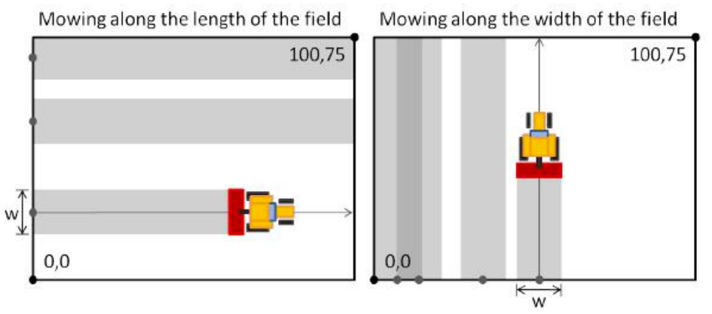
Example: Lawn Mower 4954
The grass field in a the stadium is 100m long, 75m wide.
The grass is mowed every week with special lawn mowers, always using the same strategy:
First, they make a series of passes along the length of the field.
Then they do the same along the width of the field.
All passes are straight lines, parallel to the sides of the field.

Slide 26
Lawn Mower 4954 (cont.)
The new gardner likes to choose random starting positions for each of his passes.
He is afraid of not doing a good job and being fired, so he has asked you to help him.

Slide 27
Lawn Mower 4954 (cont.)
Write a program to make sure that the grass in the field is perfectly cut:
All parts of the field have to be mowed at least once when the mower goes from end to end, and again when the mower goes from side to side.
The grass field in a the stadium is 100m long, 75m wide.

Slide 28
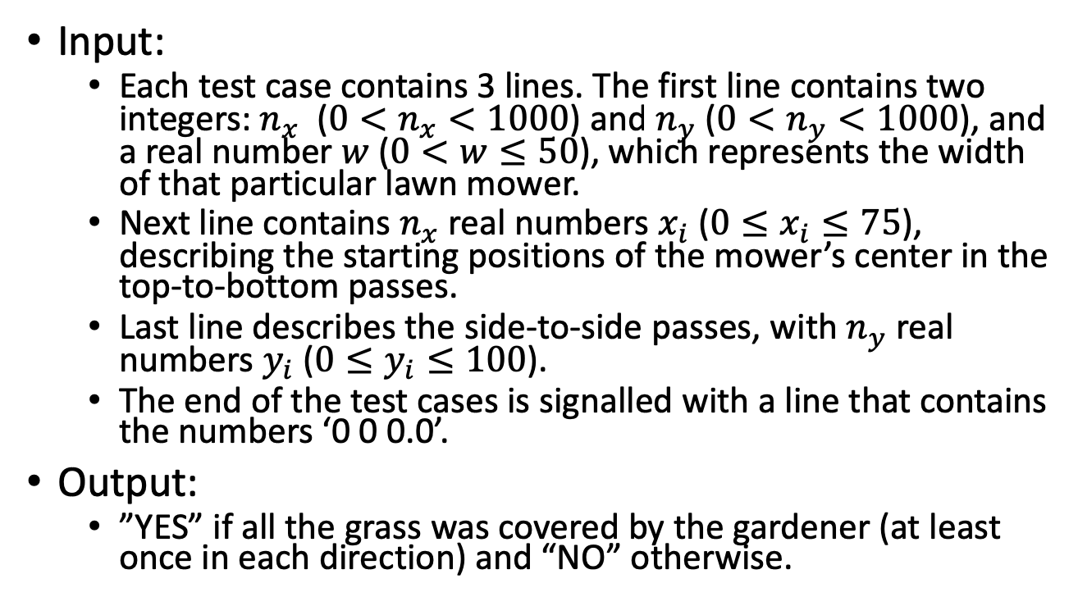
Lawn Mower 4954 – Input

Slide 29
Lawn Mower 4954 – Sample Input
8 11 10.0 0.0 10.0 20.0 30.0 40.0 50.0 60.0 70.0 0.0 10.0 20.0 30.0 40.0 50.0 60.0 70.0 80.0 90.0 100.0 (Output: YES)
4 5 20.0 60.0 10.0 30.0 50.0 30.0 10.0 90.0 50.0 70.0 (Output: NO)

Slide 30

Lawn Mower 4954
Any ideas?

Slide 31
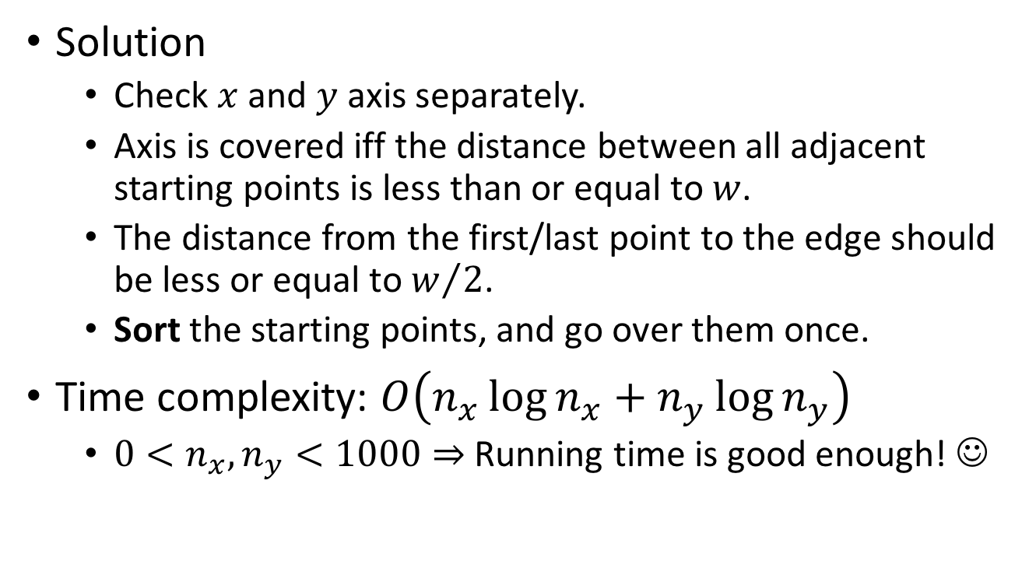
Lawn Mower 4954 – Solution

Slide 32
#include <iostream>
#include <algorithm>
#define MAX 1001
using namespace std;
int main()
{
int nx, ny, i;
double w;
double x[MAX], y[MAX];
while (cin >> nx)
{
cin >> ny >> w;
if ((nx == 0)&&(ny == 0)
&&(w == 0))
break;
for (i = 0; i < nx; ++i)
cin >> x[i];
for (i = 0; i < ny; ++i)
cin >> y[i];
sort(x, x+nx);
sort(y, y+ny);
if ((x[0]>w/2)||(x[nx-1]<75-w/2)||
(y[0]>w/2)||(y[ny-1]<100-w/2))
{
cout << "NO" << endl;
continue;
}
for (i = 0; i < nx-1; ++i)
{
if (x[i+1]-x[i] > w)
{
cout << "NO" << endl;
break;
}
}
if (i != nx-1)
continue;
for (i = 0; i < ny-1; ++i)
{
if (y[i+1]-y[i] > w)
{
cout << "NO" << endl;
break;
}
}
if (i != ny-1)
continue;
cout << "YES" << endl;
}
return 0;
}

Slide 33
Conclusions from the Code
Input/Output should be as simple as possible
No need to check for input errors
Pay attention to edge cases!
Feel free to copy and paste
Simple variable names
Sometimes you do have to refactor your code and solve bugs. Look for the sweet spot between quick writing and code clarity.

Slide 34
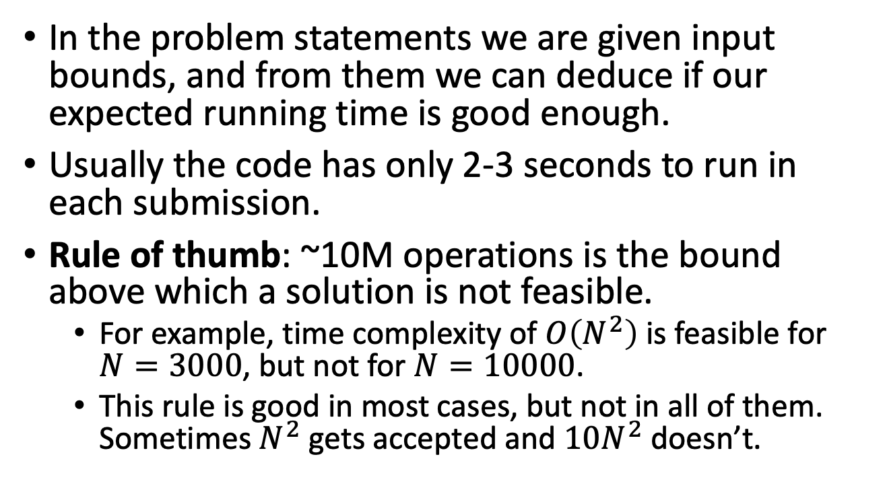
Complexity in the Competition

Slide 35
Additional Materials
In ACM-ICPC, contestants are only allowed to use C++ and the STL data structures (or Java and the standard library)
The official documentation of C++ and STL is given in the competition.
In addition, you are allowed to bring up to 25 pages of printed materials.
A good reference sheet is very useful in the competition!
We recommend starting to gather materials now.

Slide 36

6823 - Counting Substhreengs
Substrings are strings formed by choosing a subset of contiguous characters from a string (This is well known)
A Substhreeng is a substring which complies to the following additional requirements:
It is non-empty, and composed entirely of base 10 digits.
Interpreted in base 10 (allowing extra leading zeros), the resulting integer is a multiple of 3.

Slide 37
Example
The string ‘130a303’ contains 9 substhreengs:
130a303
130a303
130a303
130a303
130a303
130a303
130a303
130a303
130a303

Slide 38
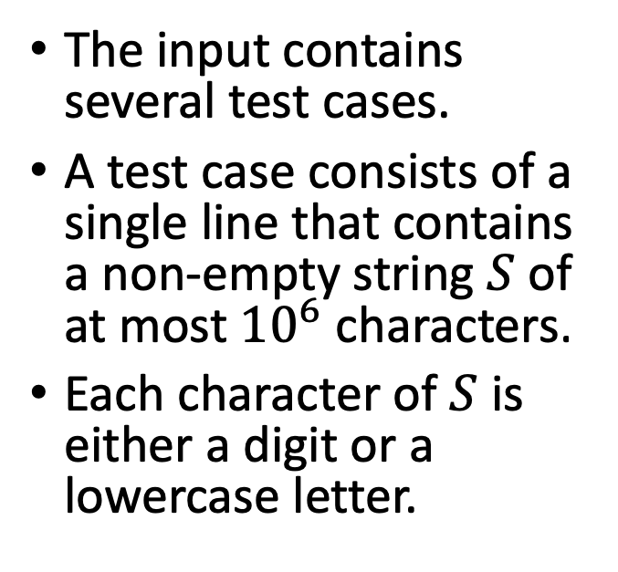
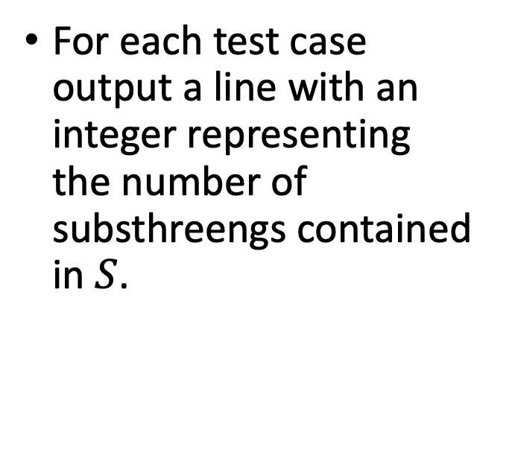
Input/Output
Input
Output

Slide 39
Input/Output
Input
Output
130a303
0000000000
icpc2014regional
9
55
2

Slide 40
6823 - Counting Substhreengs
Any Ideas?

Slide 41
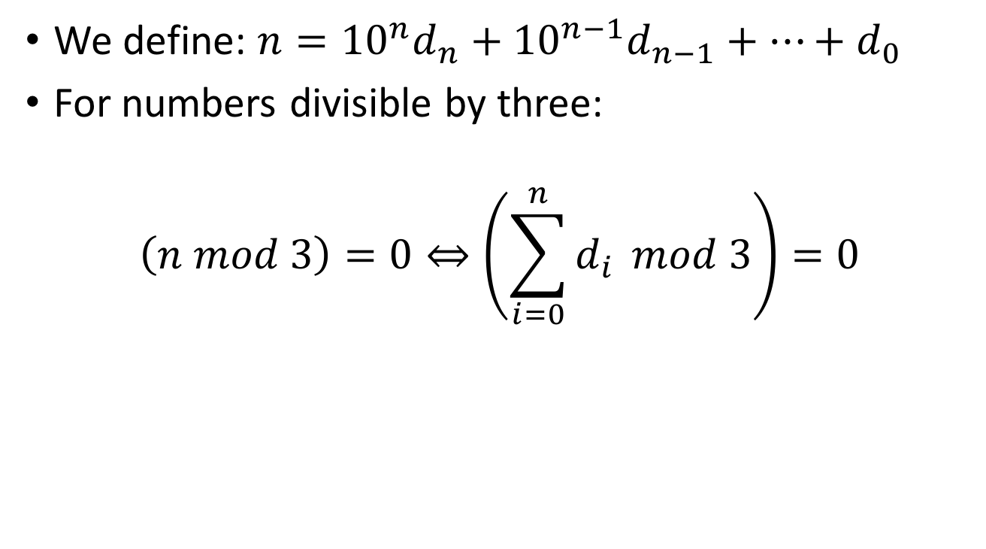
How Can We Solve It?
Notes:
First observation: handle numbers separated by letter separately and sum them up. Second observation: a number is divided by 3 iff the sum of its digits divide by 3. So now we need to solve: given a sequence of digits, how many substrings have their sum divided by 3? We can go over all possibilities, and this will take quadratic time, or we can use the prefix sum trick to use only linear time.

Slide 42
20144
Original Number | 2 0 1 4 4
Prefix Sum | 2 2 3 7 11
Prefix Sum mod 3 | 2 2 0 1 2

Slide 43
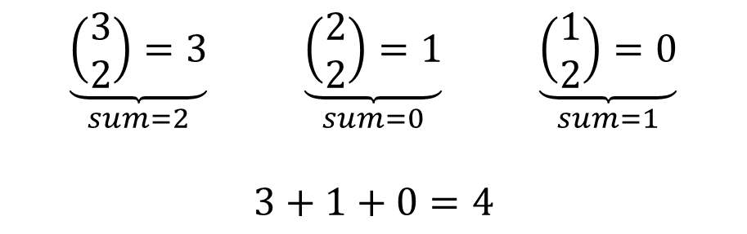
20144
Original Number | 2 0 1 4 4
Prefix Sum | 0 2 2 3 7 11
Prefix Sum mod 3 | 0 2 2 0 1 2

Slide 44
int main() {
string S;
while(cin>>S) {
S += "$";
long long total_substhreengs=0;
vector<long long> hist(3,0);
hist[0]=1;
int digit_sum=0;
for(unsigned int i=0; i<S.size(); ++i) {
int num = char(S[i])-'0';
if ((num>=0) && (num<=9)) {
digit_sum += num;
digit_sum %= 3;
hist[digit_sum]++;
} else {
for(int k=0; k<3; k++) {
total_substhreengs += hist[k]*(hist[k]-1)/2;
}
hist=vector<long long>(3,0);
hist[0]=1;
digit_sum=0;
}
}
cout << total_substhreengs << endl;
}
return 0;
}

Slide 45

4507 – Darts
Players start with a score of N points (typically, N = 501) and take turns throwing darts.
The score of each player decreases by the value of the section hit by the dart, unless the score becomes negative, in which case it remains unchanged.
The first player to reach a score of 0 wins.

Slide 46

4507 – Darts
Player A throws the darts at random, and consequently they land with equal probability in each of the sections of the dartboard.
If Player B aims at a certain section, the dart has the same probability of landing in the correct one as in each of the two adjacent ones (the neighboring regions to the left and right).
Moreover, he is completely aware of his ability and sober enough to aim at the section that maximizes his probability of winning

Slide 47
4507 – Darts
Given the initial score of both players, can you determine the probability that the first player wins? Of course, being the first to throw a dart might be advantageous, so the answer depends on who plays first.

Slide 48
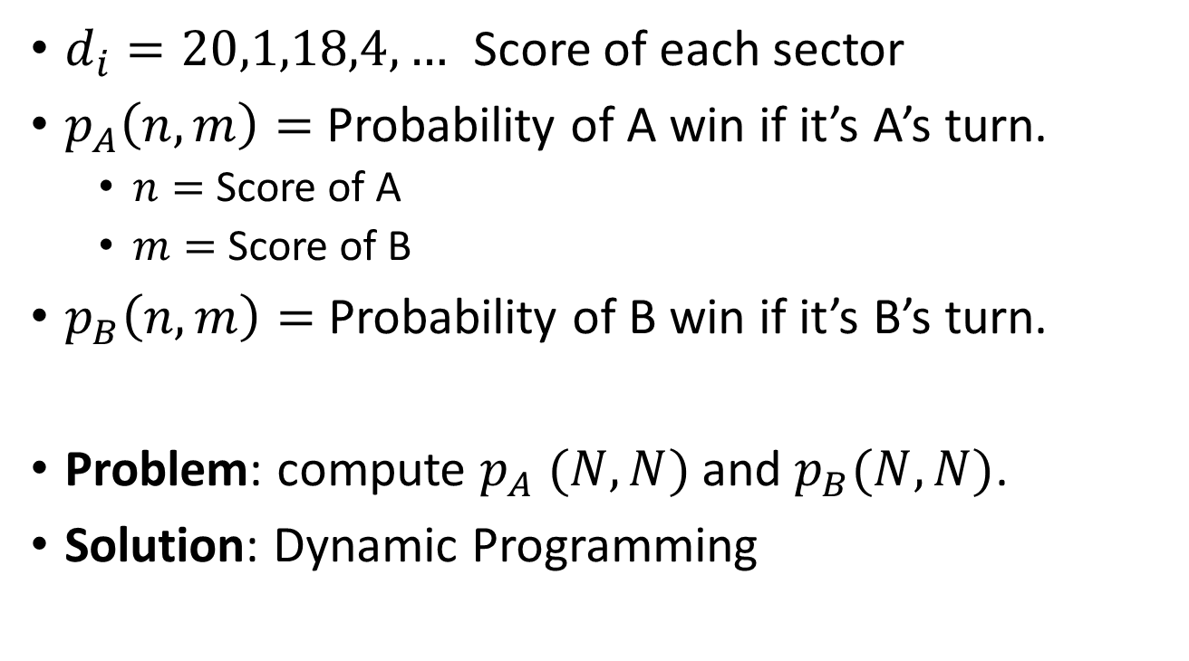
4507 – Darts

Slide 49
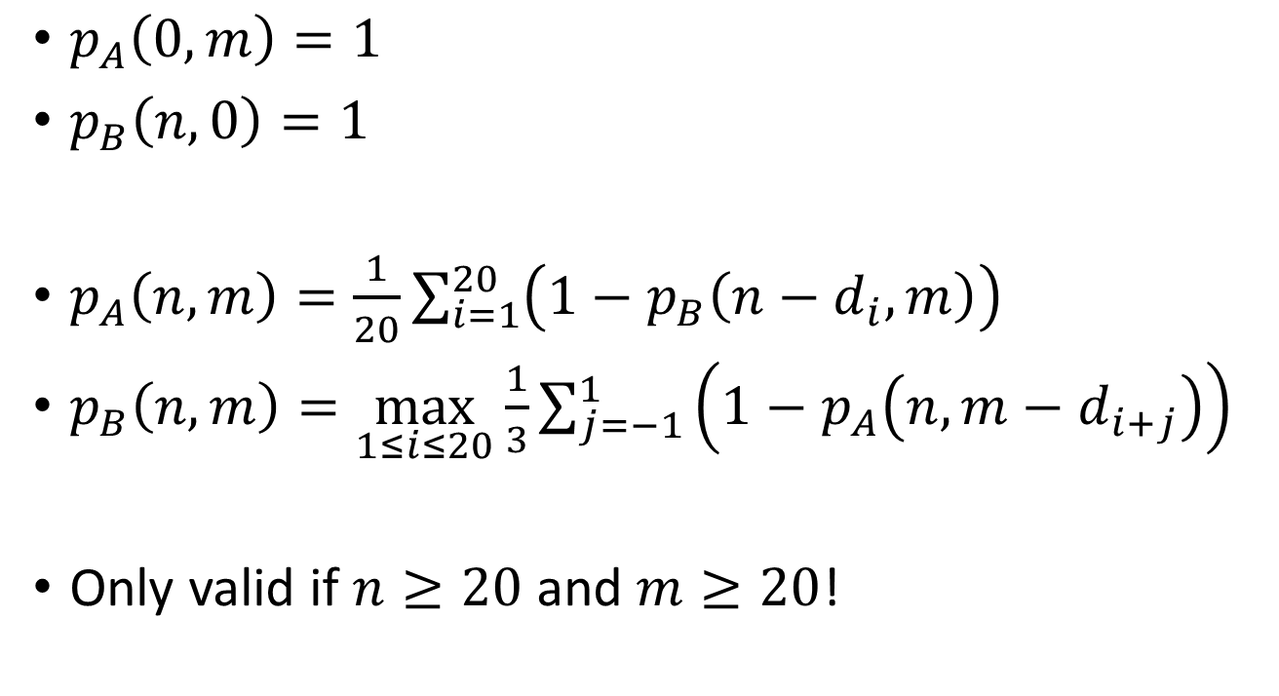
Recurrence

Slide 50

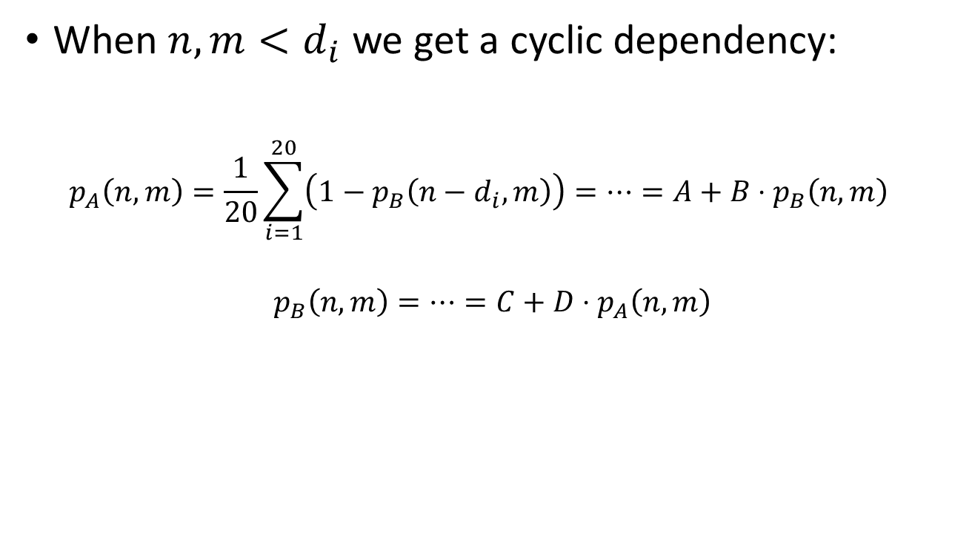

Slide 51
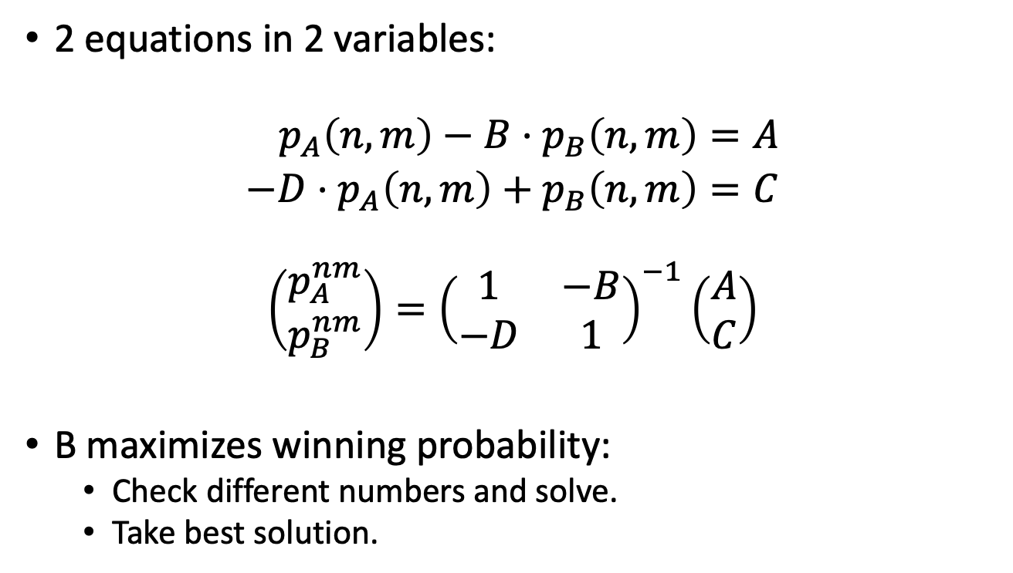

Slide 52
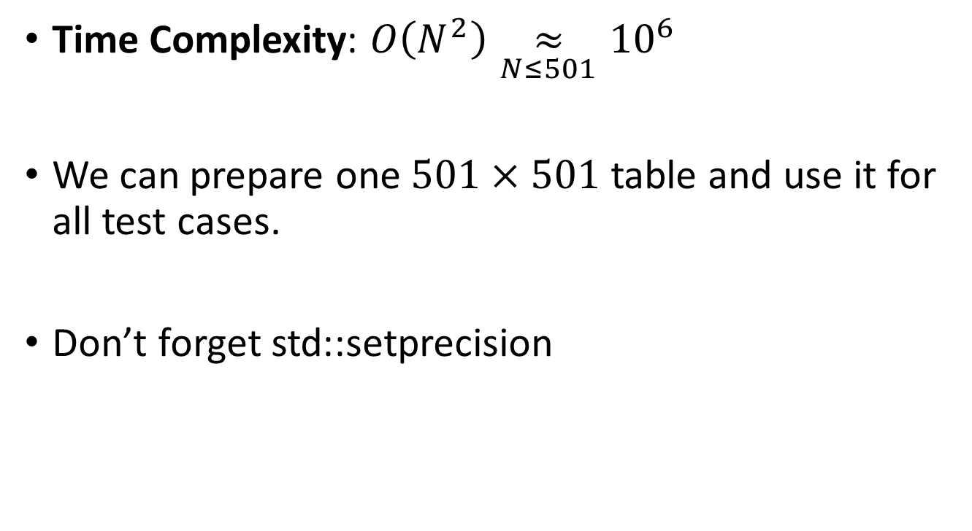
Notes

